Slide 1
TEMPERATURE BASED FAN SPEED CONTROLLER

Slide 2
Group 14
G VIVEKANANDHAN (20181CSE0211)
HARSHA HASADYA SON NT (20181CSE0264)
HARSHA K (20181CSE0265)
PALTERU KAUSHIK (20181CSE9046)

Slide 3
Objective
01
02
Components used
03
Circuit diagram
04
Demonstration
TABLE OF CONTENTS
05
Outcome screenshots

Slide 4
OBJECTIVE
1

Slide 5
Objective
To upload the data to the cloud and visualize it.
To control the fan speed automatically based on room temperature.
To send a notification to user’s mobile phone regarding the fan status

Slide 6
COMPONENTS USED
2

Slide 7
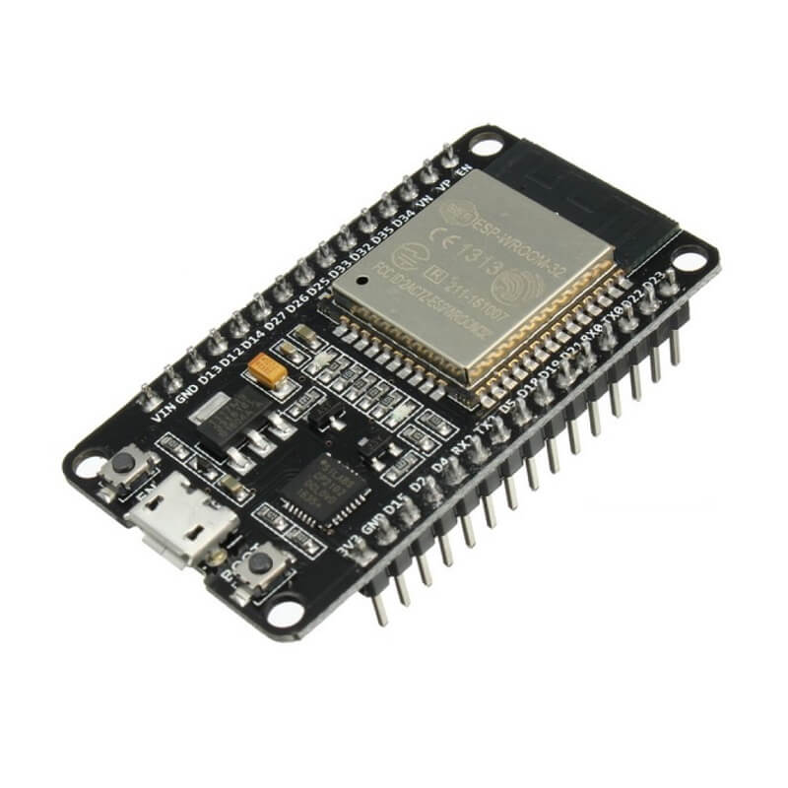
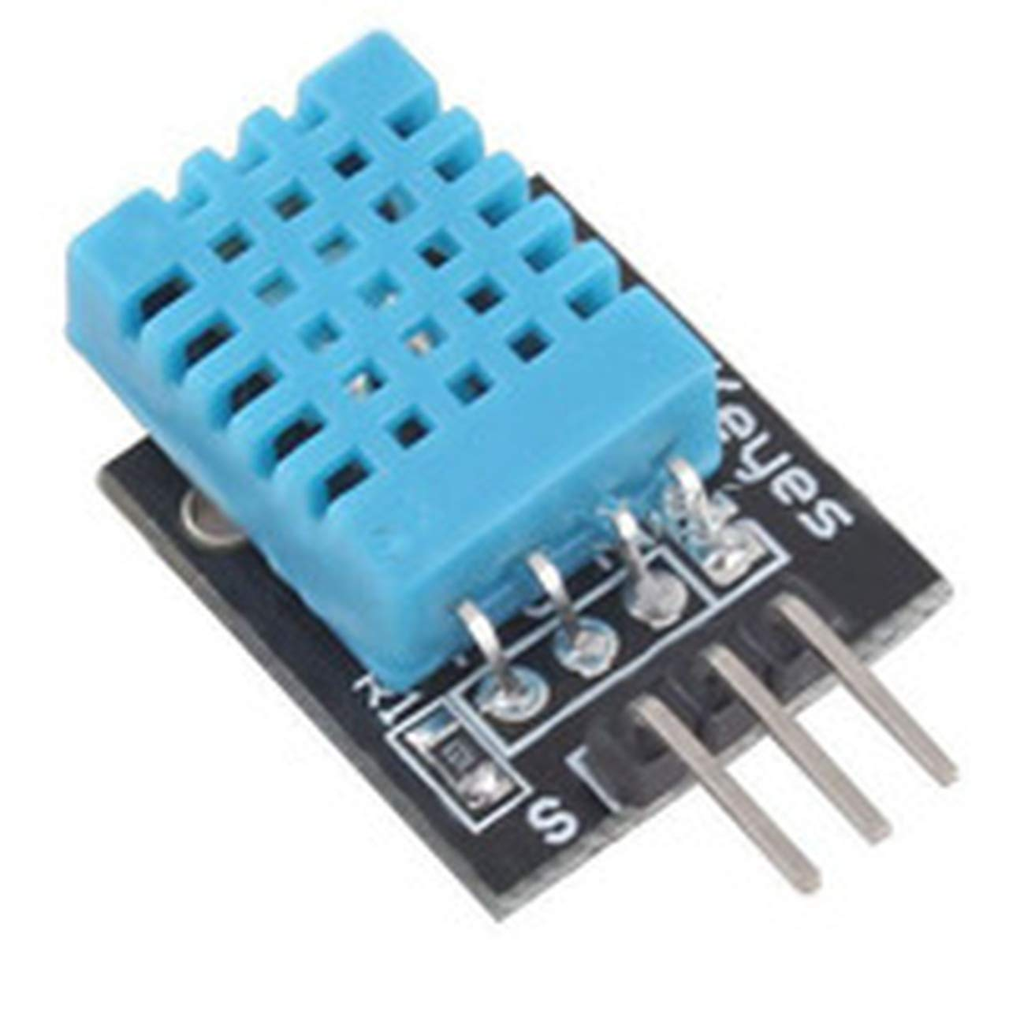
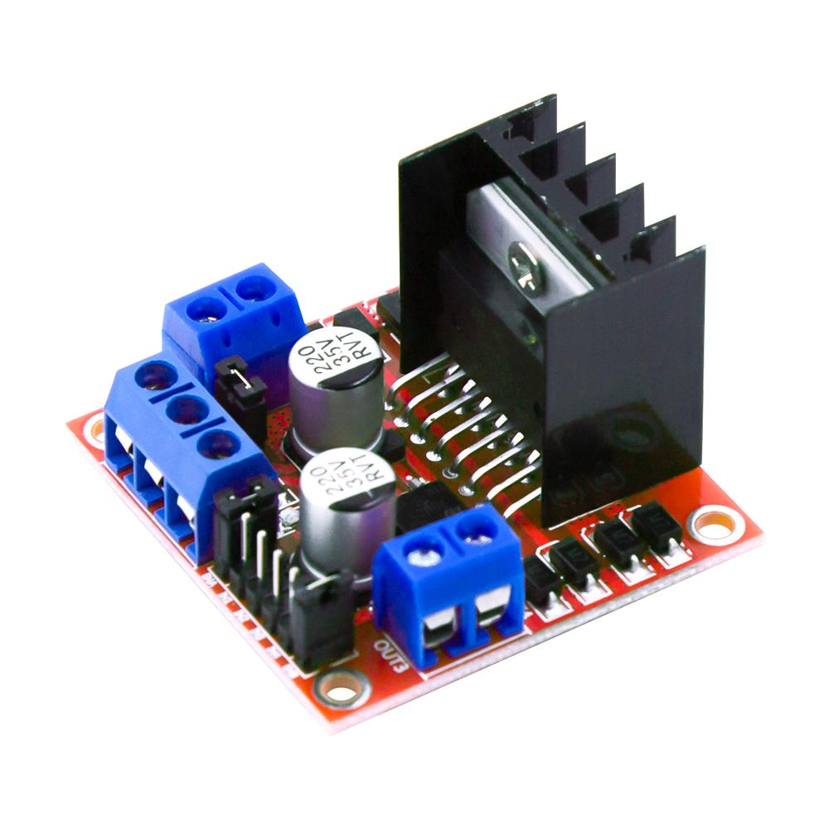
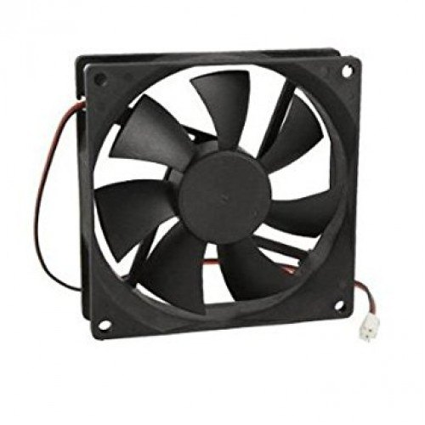
Components used
12V DC Fan
NodeMCU ESP32
DHT11 Sensor
L298N Motor Driver

Slide 8
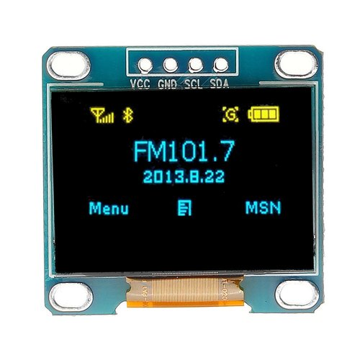
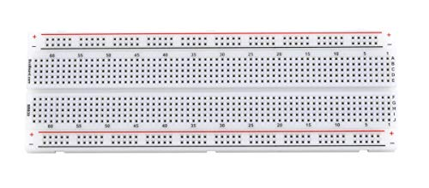


Components used
Bread Board
Battery
OLED Display
Jumper wires

Slide 9
CIRCUIT DIAGRAM
3

Slide 10
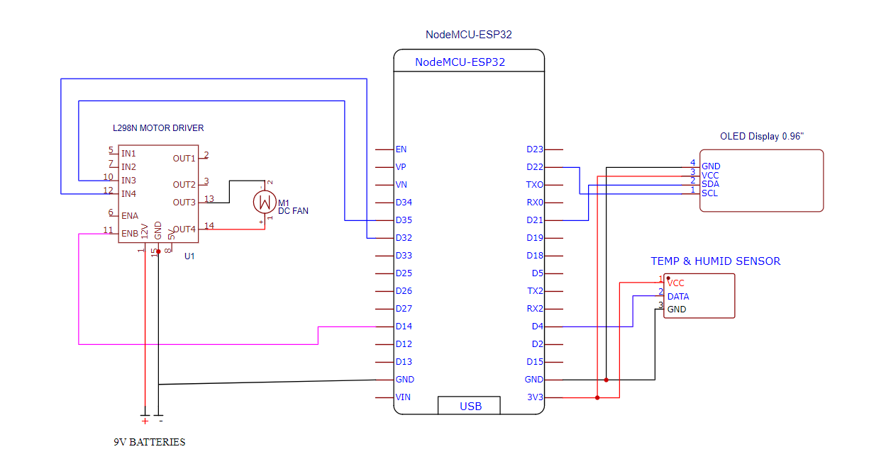
Circuit Diagram

Slide 11
DEMONSTRATION
4

Slide 12
Demonstration Video

Slide 13
OUTCOME SCREENSHOTS
5

Slide 14
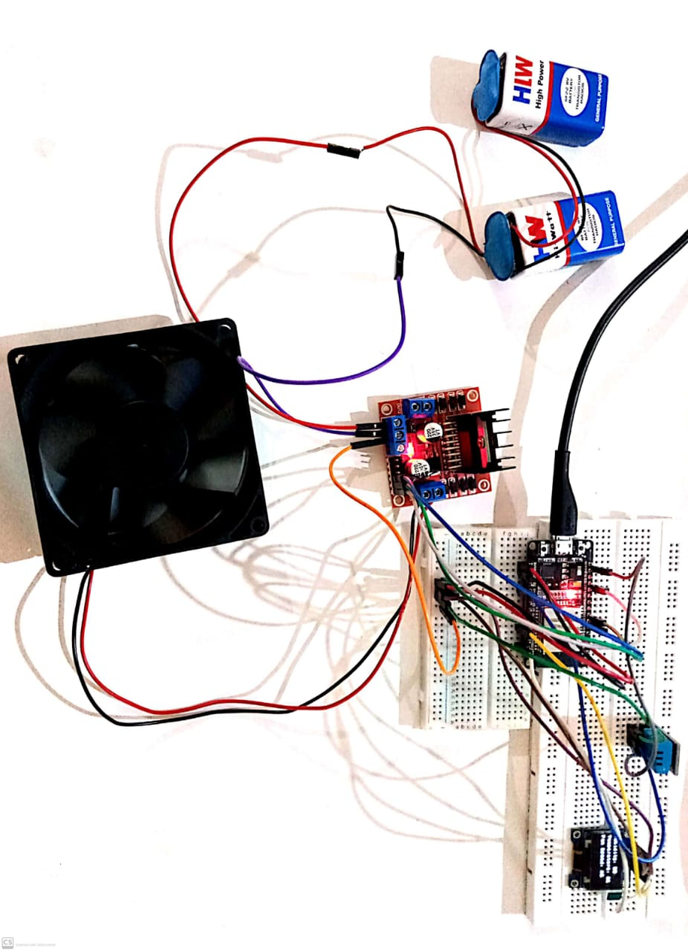
Complete picture of our project

Slide 15
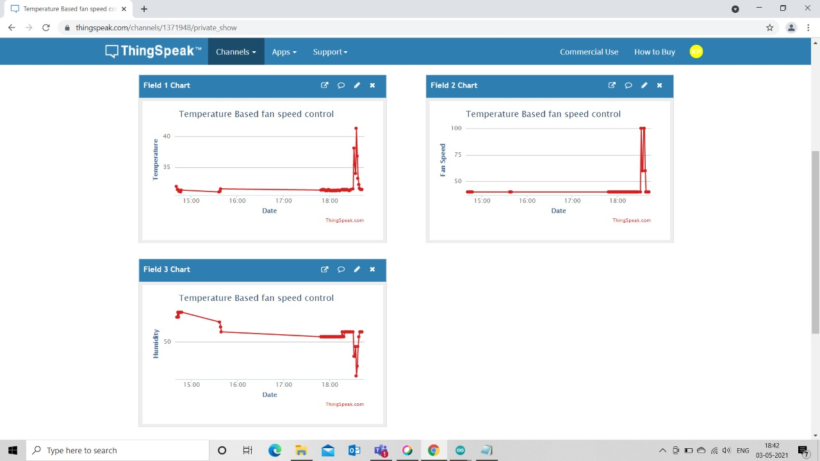
Data Visualization using ThingSpeak

Slide 16
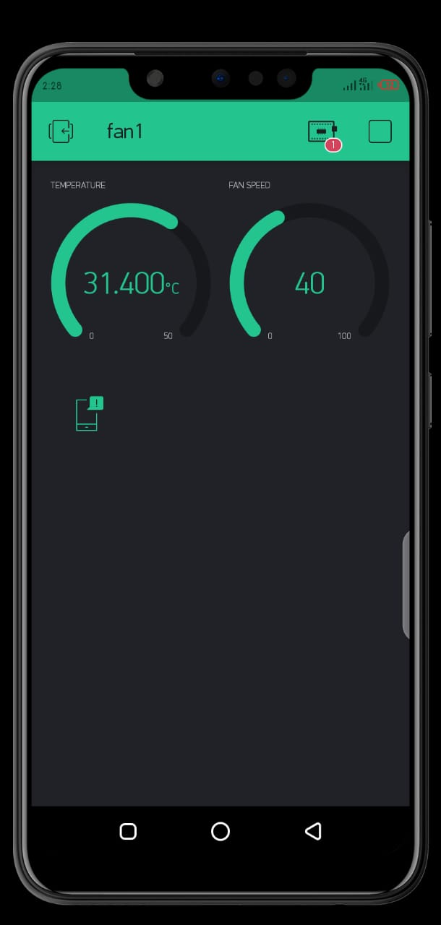
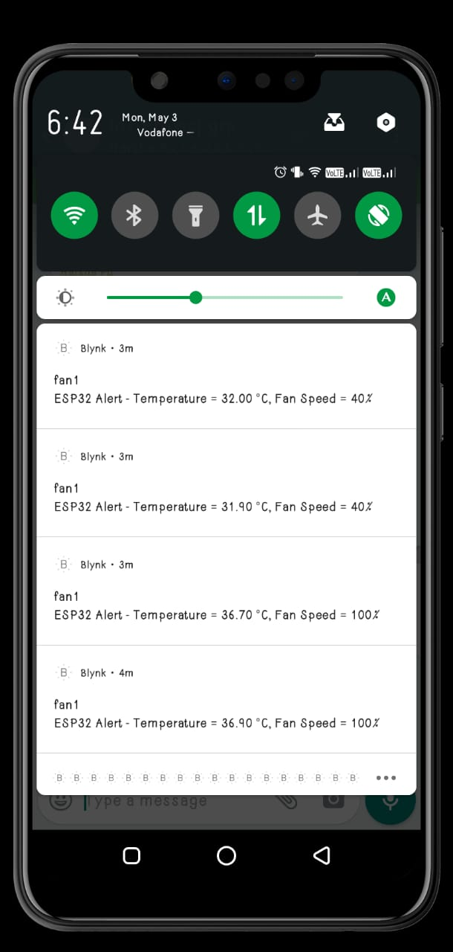
Blynk app

Slide 17
THANK YOU

